Slide 1

DriverPass System Analysis
[Tam Phan]
Notes:
[No speaker notes required for this slide.]

Slide 2

System Requirements
Functional requirements:
The system shall give the user an ability to schedule an appointment
The system shall give the user a choice to choose package tier
Non-Functional requirements:
System update constantly to match up with user’s behavior change
AWS cloud service support the system using AWS Backup and AWS database
Notes:
With functional requirement, DriverPass let user choose either to schedule their own appointment based on availability or choose their prefer package tier for lessoning purposes. After the system done with verification process in scheduling, they will be able to track or cancel their appointment. Package will have three tier for better support
With non-functional requirement, DriverPass will update constantly with customer’s change such as cancel appointments in the application to avoid any scheduling conflict. Also, system utilize AWS cloud for better online support and storage support so customer will not be worrying about online outage and they can download their data instantly.

Slide 3
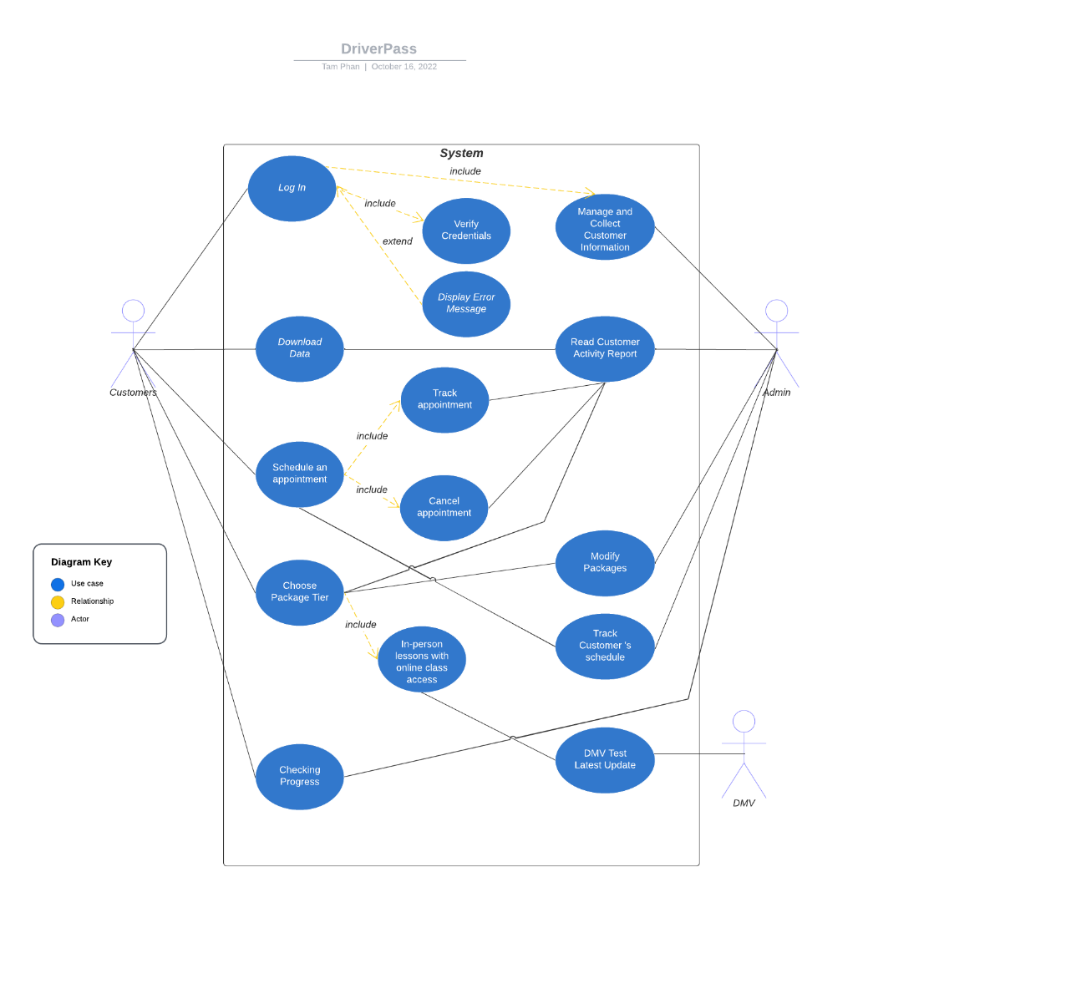
Use Case Diagram
Notes:
In this use case diagram, we will have customer, admin and DMV are the main user for this system. As mention on the system requirements, customer will have several options to choose from the user interface such as download data, schedule appointment, choose package tier, and checking progress after the login verification process is successfully complete. Admin will oversee every customer activity to managing purposes and DMV will align with lesson requirements from package tier for up to date testing documents

Slide 4
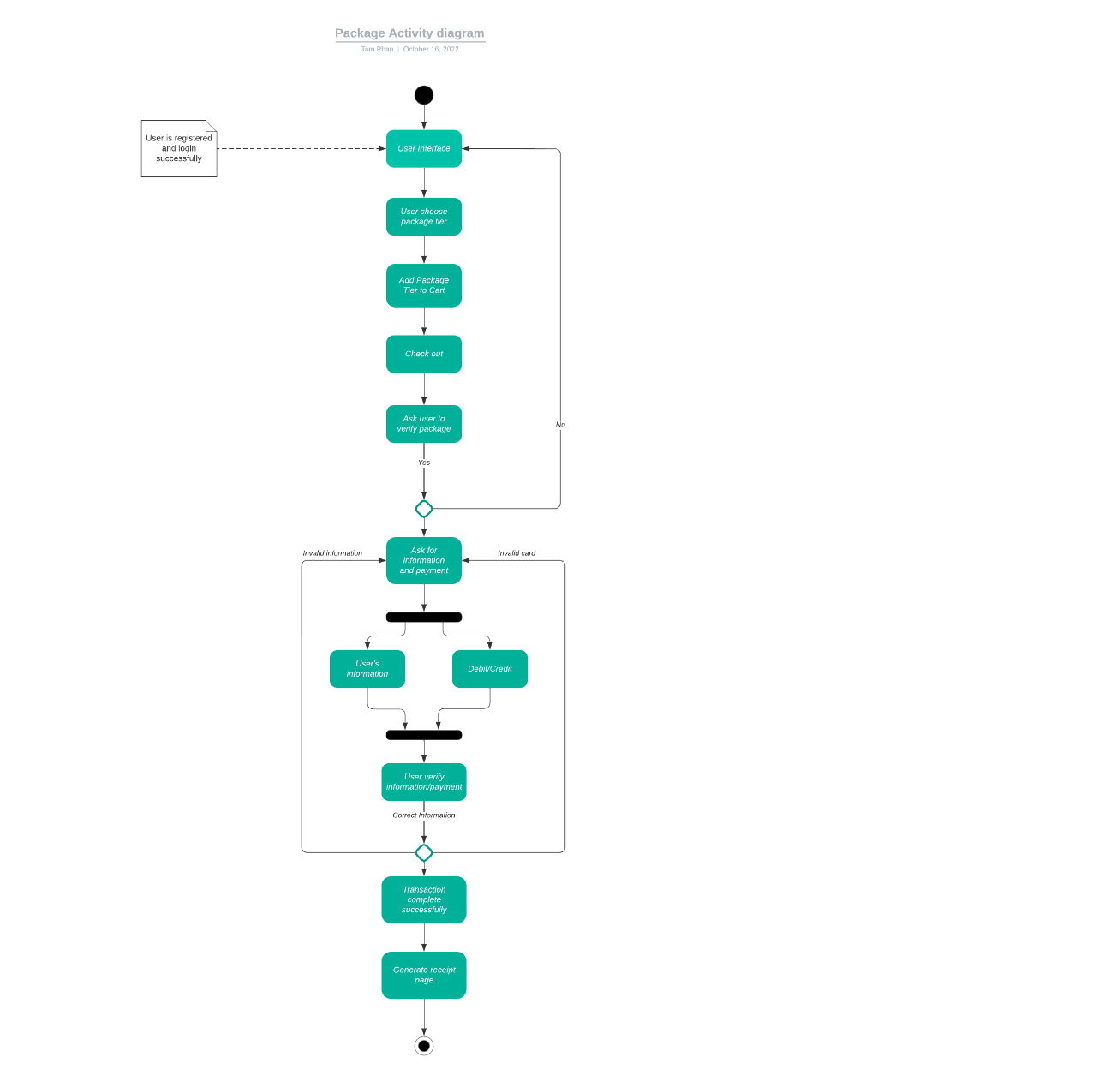
Activity Diagram
Notes:
In this activity diagram, after the system done with the verification process, user can choose their package tier based on their preferences, but the system will ask user to verify their choice again to make sure everything is correct. If the answer is no, user will go back to choose their package again. If the answer is yes, they can proceed to a next step which is user’s information and payment.
Another verification will pop up again to verify their valid information and credit or debit card, the transaction will be completed and bill will be generated if everything is accurate since system will access database from customer and bank to compare with user’s input. If one of them is incorrect, user will go back to the user’s payment and information.

Slide 5
Security
System will have a two factor authentication for user to login without using password
Using password required a combination of string, integer, symbols and length for better security
Any brute force attempt will be reported straight to the IT, so developers can prevent it asap.
Notes:
User can use mobile authentication to login without enter password by using mobile phone number for better protection, so that password can’t be compromised from third party app. Other than that, system would imposed a password length with a combination of uppercase, lowercase, number and symbols for security.
Brute force attempt such as too many failed login will be reported straight to IT, so they can lock the account immediately

Slide 6
System Limitations
System doesn’t support iOS or android application
System will not run properly if AWS cloud is disrupted
Notes:
As of right now, there is no pathway for iOS or Android application since it will require more time to develop and maintain. The system can only be accessed to platforms with mobile browser. Moreover, system choose AWS cloud for better connection to the internet since they have several supported networks to maintain their service, but if all of them is disrupted, DriverPass will not run properly because it depends on AWS cloud.

